Slide 1
How to prepare for your test
All opinions are those of the presenter

Slide 2
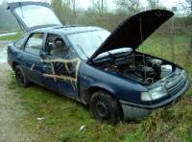
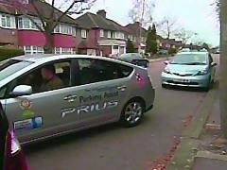
What to do now
Documentation
Licence, Reg. Doc., MOT, Tax, Insurance (test date)
Is the car safe and legal?
Tyres, windscreen, wipers, bodywork, exhaust
Book time off work for the test
Book the day (or afternoon) before as well
Practice, practice, and more practice
Make sure you can perform manoeuvres
Hone commentary skills (but it is optional)
Prepare your cockpit drill

Slide 3
What is it like?
Very like an observed Sunday drive
Easy to treat it in the same way
Remember it is a test
You can be passive
It is better to participate actively
No tricks, but be vigilant

Slide 4
Help him to have the right opinions about you
The examiner will be fair and balanced and take everything into account
However, it is better if right at the start he thinks “wow this is a good driver” and/or “maybe we will go on the interesting route”
You need to help him think that
You need to look as though you are good, and tell him via commentary that his instincts are right
This is not manipulation, it is making the best of the opportunity

Slide 5
The examiner
Serving or ex-police driver
Wants you to pass
Trained to put you at ease
Trained to give you best chance to pass
But will give you a fair test and ensure that you are up to standard
Has done more driving tests than you can imagine

Slide 6
The examiner – police driver
Expects to drive many different cars
Will have a drill to find where the handbrake is
Is car ready? What do the dials/lights tell me?
Am I ready to drive it?
Can I pursue at 120mph?
Commentary is normal
Many tests – understands how you feel

Slide 7
Cockpit drill – why?
Examiner is used to people doing it
Confirms that you are in-system before you even start driving
Avoids embarrassing gaps or “did you see Eastenders”
Gives you a run-in to commentary
Tells him you are an advanced driver before you have even turned the key

Slide 8
Cockpit drill – what?
Your choice
Seat belts
Doors shut
Mirrors okay
Driving conditions – hazards
Where am I?
Handbrake/Neutral (Park)
Warning lights
Heating/Ventilation
Lights on?
Moving brake test
You can prepare it, but do not learn it.

Slide 9
Cockpit drill – what?
73: Before setting off. You should ensure that:
you have planned your route and allowed sufficient time
clothing and footwear do not prevent you using the controls in the correct manner
you know where all the controls are and how to use them before you need them. All vehicles are different; do not wait until it is too late to find out
your mirrors and seat are adjusted correctly to ensure comfort, full control and maximum vision
head restraints are properly adjusted to reduce the risk of neck injuries in the event of an accident
you have sufficient fuel before commencing your journey, especially if it includes motorway driving. It can be dangerous to lose power when driving in traffic.

Slide 10
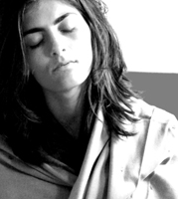
The day before
Chill out
Drive for a couple of hours
Commentary
Go to the meeting place
Know how long it will take to get there
Plan where to park
Drive in all directions and note signs/junctions/hazards – plan commentary
Practice Manoeuvres
Wash and Vacuum
Remove furry dice – look as though you care about driving
Top-up oil, water, petrol
Confirm tyres, windscreen etc okay
Locate documentation
Re-read Highway Code and Roadsigns

Slide 11
Going/arriving
Finalize weather part of cockpit drill
Be early
Park so you can get away easily
Reverse!

Slide 12
The test
Talk
Talk
Examiner
Will explain
Check documents
Handover
You
Cockpit drill
Move off – brake test
Start commentary as you hit the tarmac
Talk
Talk
Talk
Talk
Talk
Talk
Talk
Talk

Slide 13
The test
Reduce commentary over a few minutes
Do not try to drive differently to normal
Aim to say something every couple of minutes
Do not lose concentration when he talks about Eastenders
He will say that he is going to recommend you for membership of IAM
De-brief

Slide 14
What is he looking for?
What is the difference between my know-it-all nephew who has just passed his normal test?
Knows Highway Code
Knows road signs
Can do a parallel park
Why are you advanced and he is not?
(You need to know all that stuff too by the way)

Slide 15
What is he looking for?
Safe, Smooth, Systematic
You cannot be advanced if you are not in-system
How will he know you are in-system?
TELL HIM
Not (necessarily) perfect

Slide 16
Unforgivable sins
Breaking the law
Persistent smaller sins
Indicates system failure

Slide 17
After the test
Complete form on web site (see next slide)
Or tell David that you have passed
Be involved in the group
Special Assessment

Slide 18
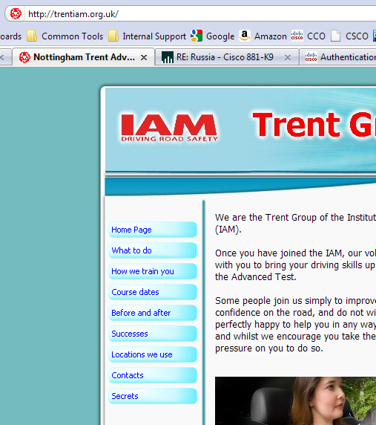
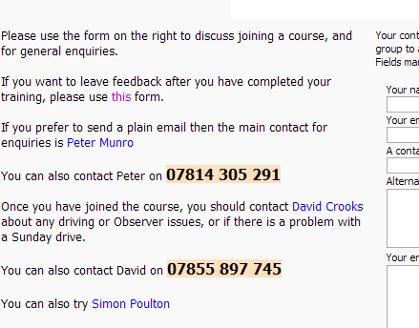
trentiam.org.uk

Slide 19
Questions

